Slide 1

Thinking Like a Scientist
Tom Carpenter, PhD
Stephen Elston, PhD

Slide 2
Premise
Very smart data scientists answering research questions at Microsoft
Share insights from professional science into research for “understanding” people
Notes:
Using data to predict and answer questions about people, behavior

Slide 3

Tom Carpenter, PhD
Research & Statistical Consultant
Associate Professor, Psychology @ Seattle Pacific U.
Notes:
Expertise:
Statistical modeling and computing
Research design and methodology
Human psychology (emotion, bias, consumer behavior)

Slide 4
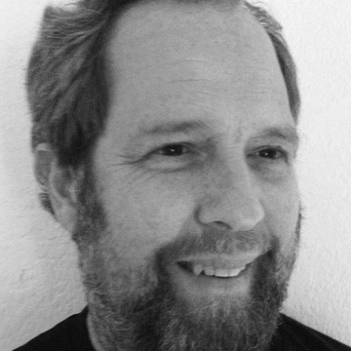
Stephen F. Elston, PhD
Managing Director, Founder at Quantia Analytics LLC
Instructor @ U. of Washington, Harvard
Author, Data Science in the Cloud with Microsoft Azure
Machine Learning (O’Reilly)

